Slide 1

UFC Match Outcome Predictor
A quest to predict the unknown

Slide 2
Quest for W’s
The What, When & Where of Winning
Just like fighters strive to win, we strive to harness the power of data science to help us win by answering complex questions.
Our quest is to explore if there is a way to wrangle and distill data such that you’re able to determine future outcome of fighters based on previously fought bout data metrics.

Slide 3
What?
Why?
Where?
01
02
03
Topic:
Our Process:
Source:
Use data and fighter statistics to create an educated prediction on who will win the fight.
As fans it would be interesting to best predict who will win a fight.
We acquired a dataset from UFC saved in Kaggle.com

Slide 4
What We Plan On Answering:
1. What are the top 5 fighter metrics that contribute to winning a UFC match?
2. Which of the fighter metrics carry more weight than the others?
3. How much do biometric physical factors, i.e. age, height, weight, affect the outcome of the match?
4. Does having a higher rank predict the outcome?
5. Do the number of win streaks necessarily predict a higher chance of winning?

Slide 5
Data Exploration phase
Blue
Red
Differences in the average accuracy of takedowns taking place between fighters were calculated by using the following function: “Blue corner score minus (-) Red corner score” where a negative score actually favors the Red corner fighter.
Exploring historical data of past matchups in the UFC for past multiple years, it was found that the great majority of the time, the fighter in the red corner has a slightly greater chance as the victor in a match-up

Slide 6



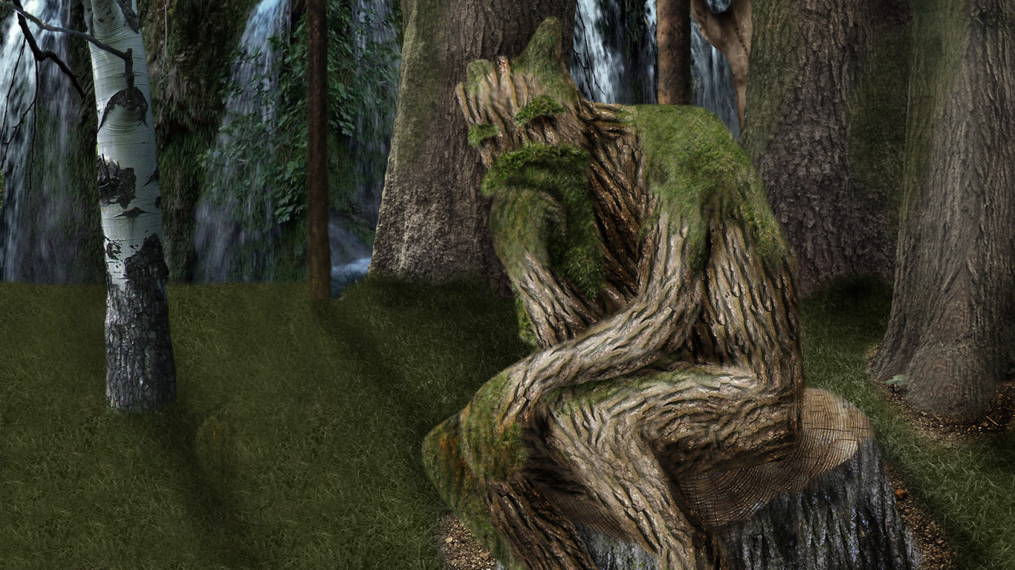
Analysis Phase
-We will compare the following 4 models to see which model best fit our data, research requirements and structure.
K-Nearest Neighbors
Random Forest Model
Decision Trees
Logistic Regression Models
Supervised learning algorithm
Simple, supervised machine learning algorithm
Builds regression or classification models in the form of a tree structure
Basic statistical model that uses a logistic function to model a binary dependent variable

Slide 7
Machine Learning Analysis I
Preliminary data preprocessing, feature engineering, feature selection and decision-making process
Using the resources-master.csv file, we first wanted to create a baseline classification model Simple_Model.ipynb in order to establish a benchmark of how well a winner could be predicted without data preprocessing and feature engineering. Using the Dummy Classifier, which allows us to run the model with null values, the model predicted winners with 51.75% accuracy.
We have a very robust dataset with 137 columns of data. In order to achieve better model performance we must:
Feature Engineer - Limit input features by combining similar variables in order to increase correlation
Eliminate 'noisy' data
Find null values and fill them
Encode categorical variables

Slide 8
Machine Learning Analysis II
How data was split into training
We then set out to create a model that would perform better than our baseline model, by first preprocessing the data and implementing feature engineering- data_preprocessing.ipynb. In this dataset we were dealing with 137 variables many of which contained a significant amount of null values. In order to ensure key variables were not eliminated, we first encoded the winning column and ran a correlation function in pandas to see which variables most correlated to winners. After that, we recognized that the majority of our variables were duplicates in a sense—statistics for the Red Corner fighter, and statistics for the Blue Corner fighter. To increase correlation and concentrate the data, we subtracted all Red Corner statistics from Blue Corner statistics (Blue-Red) and created 'difference' variables. Then we dropped all variables that were common to both fighters in that fight; such as date, location, weight class, ect. Looking at the data further we recognized there was a large chunk of variables associated to rankings in a given weight class that contained a significant amount of null values. After further analysis only one of these rankings columns was pertinent and all the others were dropped. Then columns with strings were encoded, and false NaN columns were filled with their true value of 0.
Testing sets and model choice—limitations and benefits
For our improved model we decided to compare the results between a Random Forest classifier and a Deep Neural Networkufc_RF_vs_NN.ipynb, because we were looking to classify winners with a very large dataset. We tinkered with different train/test splits but results were best with a standard 25% test split. The RF Classifier resulted in 78% accuracy while the Deep NN resulted in 76% accuracy. It does not seem that either model was overfit, and they were able to predict winners of the fights with over 75% accuracy.

Slide 9
Description of Tools to Create Final Dashboard
Description of Interactive Elements
For our final presentation, we will utilize the following tools to create visualizations:
Google Slides
Tableau Public
Python
Seaborn
MatPlotLib.PyPlot
Pandas
Table with heat map to showcase intensity of fighter statistics against one another
Chart with label brushing to allow for automatic appearance of an identifying label when the cursor hovers over a particular plot element
Table with filters to easily select fighters statistics for side by side comparison

Slide 10
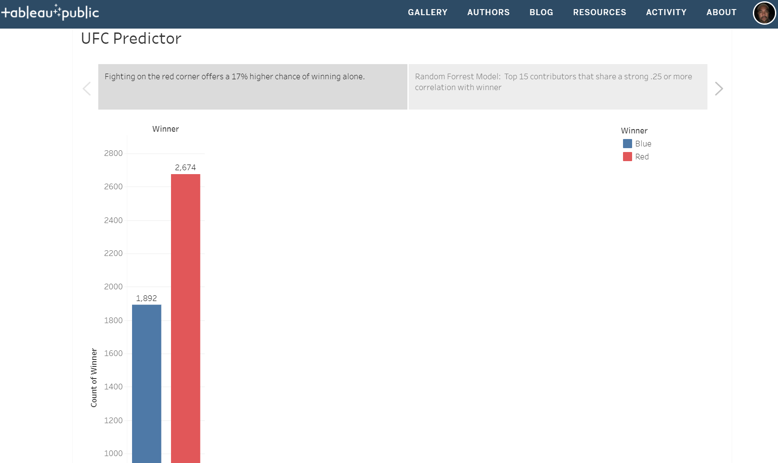
Sample 1 of Our Dashboard
URL>> https://public.tableau.com/views/UFC_16170959562780/UFCPredictor?:language=en&:display_count=y&:origin=viz_share_link

Slide 11
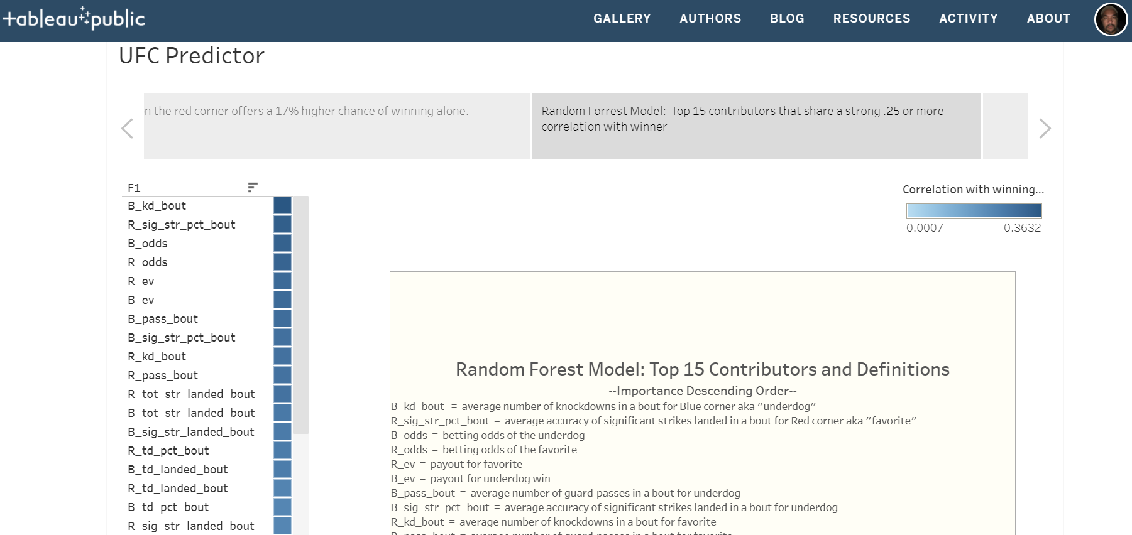
Sample 2 of Our Dashboard
URL>> https://public.tableau.com/views/UFC_16170959562780/UFCPredictor?:language=en&:display_count=y&:origin=viz_share_link

